Slide 1

INSTITUTE - UIE
DEPARTMENT- ACADEMIC UNIT-2
Bachelor of Engineering (Computer Science & Engineering)
Subject Name: Object Oriented Programming using C++
Code:20CST151
Unit-3
Topic: Try, Throw, Catch
DISCOVER . LEARN . EMPOWER

Slide 2


Object Oriented Programming using C++
Course Objectives
To enable the students to understand various stages and constructs of C++ programming language and relate them to engineering programming problems.
To improve their ability to analyze and address variety of problems in programming domains.

Slide 3



Course Outcomes
CO Number | Title | Level
CO1 | Provide the environment that allows students to understand object-oriented programming Concepts. | Understand
CO2 | Demonstrate basic experimental skills for differentiating between object-oriented and procedural programming paradigms and the advantages of object-oriented programs. | Remember
CO3 | Demonstrate their coding skill on complex programming concepts and use it for generating solutions for engineering and mathematical problems. | Understand
CO4 | Develop skills to understand the application of classes, objects, constructors, destructors, inheritance, operator overloading and polymorphism, pointers, virtual functions, exception handling, file operations and handling. | Understand

Slide 4
Scheme of Evaluation
Sr. No. | Type of Assessment Task | Weightage of actual conduct | Frequency of Task | Final Weightage in Internal Assessment (Prorated Marks) | Remarks
1. | Assignment* | 10 marks of each assignment | One Per Unit | 10 marks | As applicable to course types depicted above.
2. | Time Bound Surprise Test | 12 marks for each test | One per Unit | 4 marks | As applicable to course types depicted above.
3. | Quiz | 4 marks of each quiz | 2 per Unit | 4marks | As applicable to course types depicted above.
4. | Mid-Semester Test** | 20 marks for one MST. | 2 per semester | 20 marks | As applicable to course types depicted above.
5. | Presentation*** |  |  | Non Graded: Engagement Task | Only for Self Study MNGCourses.
6. | Homework | NA | One per lecture topic (of 2 questions) | Non-Graded: Engagement Task | As applicable to course types depicted above.
7. | Discussion Forum | NA | One per Chapter | Non Graded: Engagement Task | As applicable to course types depicted above.
8. | Attendance and Engagement Score on BB | NA | NA | 2 marks

Slide 5
CONTENTS
What is an Exception
Exception Handler Try, Throw, Catch
Notes:
Computer in the diagram is 3rd generation computer. The period of third generation was from 1965-1971. The computers of third generation used Integrated Circuits (ICs) in place of transistors. A single IC has many transistors, resistors, and capacitors along with the associated circuitry. The main features of third generation are −
IC used
More reliable in comparison to previous two generations
Smaller size
Generated less heat
Faster
Lesser maintenance
Costly
AC required
Consumed lesser electricity
Supported high-level language

Slide 6
WHAT IS AN EXCEPTION?
An exception is a problem that arises during the execution of a program. A C++ exception is a response to an exceptional circumstance that arises while a program is running, such as an attempt to divide by zero.
Exceptions are different, however. You can't eliminate exceptional circumstances; you can only prepare for them. Your users will run out of memory from time to time, and the only question is what you will do. Your choices are limited to these:
Crash the program.
Inform the user and exit gracefully.
Inform the user and allow the user to try to recover and continue.
Take corrective action and continue without disturbing the user.

Slide 7
WHAT IS AN EXCEPTION?
Many kinds of errors can cause exceptions--problems ranging from serious hardware errors, such as a hard disk crash, to simple programming errors, such as trying to access an out-of-bounds array element.
When such an error occurs, the method creates an exception object and hands it off to the runtime system.
The exception object contains information about the exception, including its type and the state of the program when the error occurred.
The runtime system is then responsible for finding some code to handle the error.
In programming terminology, creating an exception object and handing it to the runtime system is called throwing an exception.

Slide 8
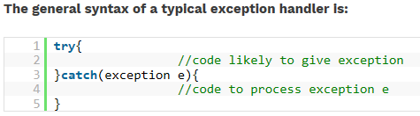
EXCEPTION HANDLING
Errors disrupt normal execution of a program. Exception handling is very necessary, and it is the process of handling errors or exceptions. It makes sure that the execution of the program is not affected by the exceptions and slowly handles them without causing any issue to the program execution.
In C++, exception handling is provided by using three constructs or keywords; namely, try, catch and throw.
Block of code that provides a way to handle the exception is called “exception handler”.
Figure 1: Syntax

Slide 9

Exception Handling Advantages
It helps the programmer to write robust and fault-tolerant programs that can deal with problems continue executing or terminate gracefully.
Exception handling also is useful for processing problems that occur when a program interacts with software elements, such as member functions, constructors, destructors and classes.

Slide 10
Exception Handling Mechanism
Error handling code basically consists of two parts.
Detect error and throw the exception (in try block)
Catch exception and take appropriate action. (in catch block)
Steps to be followed are:
Find the problem (Hit the exception).
Inform that error has occurred (throw the exception).
Receive the error information (catch the exception).
Take corrective actions (handle the exception).

Slide 11
Exception Handling Mechanism
Exception handling basically has 3 keywords:
Try
Throw
Catch
In try block, we add those blocks of statements which may generate exceptions. When an exception is detected, it is thrown using a throw statement in a try block.
A catch block defined by keyword catch ‘catches’ the exception ‘thrown’ by throw statement in the try block and handles it appropriately.
The catch block that catches an exception must immediately follows the try block that throws the exception.

Slide 12
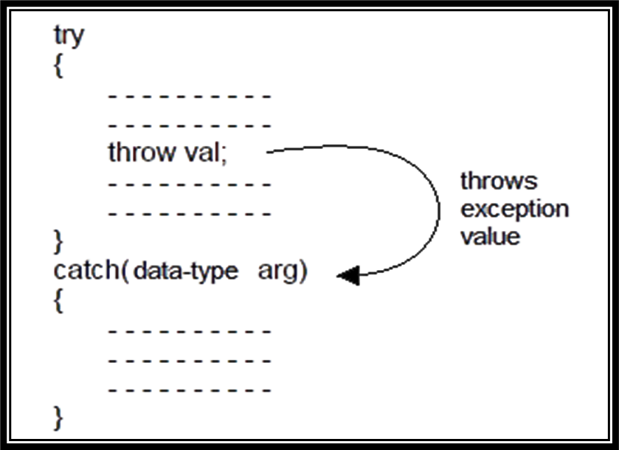
Exception Handling Mechanism
Figure 2: Depiction of try catch block

Slide 13
Throw and Catch
The throw statement is almost similar to function call. The only difference is that instead of calling the function, it calls the catch block.
In this sense, the catch block is like function definition with a parameter that matches the type of value being thrown.
The throw expression accepts one parameter as its argument and this is passed to the exception handler.
You can have a number of throw statements at different parts of your try block with different values being thrown so that the exception handler on receiving the parameter will know what restorative actions to take.

Slide 14
Throw and Catch
The exception handler can be identified by the keyword catch .
catch always takes only one parameter.
The type of the catch parameter is important as the type of the argument passed by the throw expression is checked against it and the catch function with the correct parameter type is executed.
This way we can chain multiple exception handlers and only the one with the correct parameter type gets executed.

Slide 15
Throw and Catch
try
{ // code
if ( x )
throw 10;
// code
if (y)
throw 20;
//code
}
try { // code here }
catch (int param) {
cout << "int exception";
}
catch (char param) {
cout << "char exception";
}
catch (...) {
cout << "default exception";
}

Slide 16
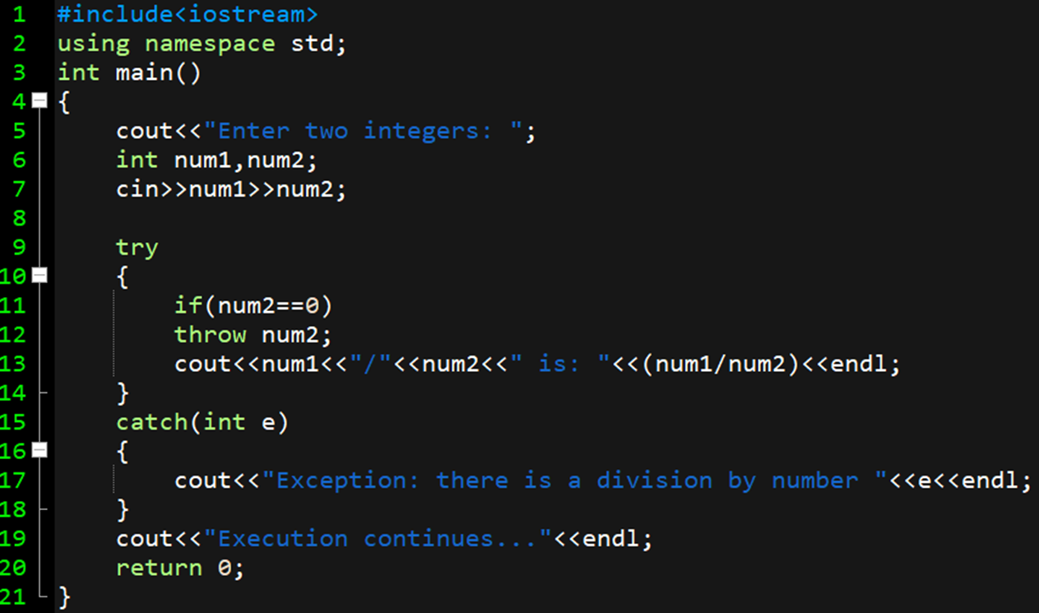

Slide 17
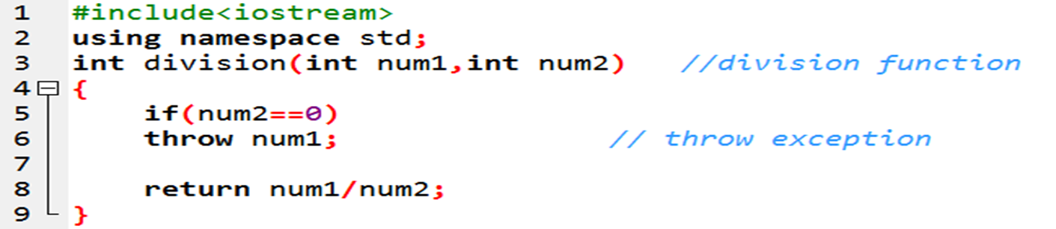
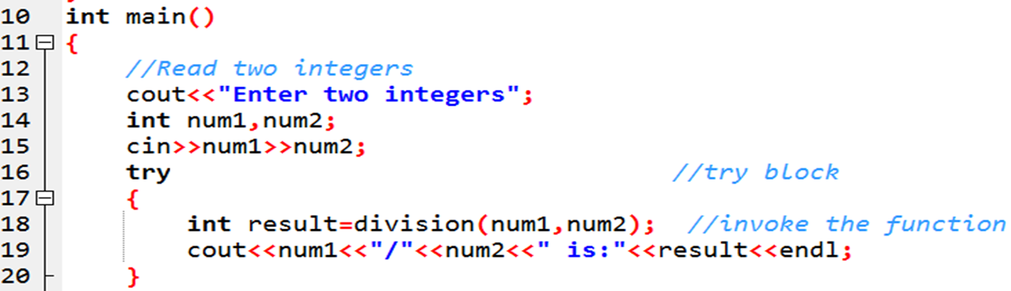
Throwing an Exception in a Function

Slide 18
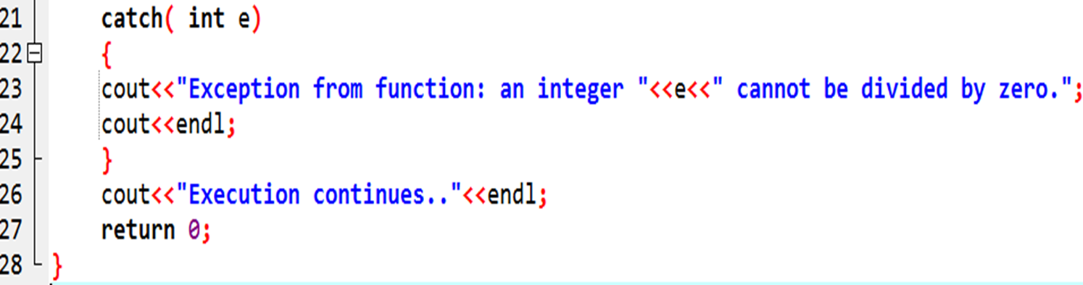
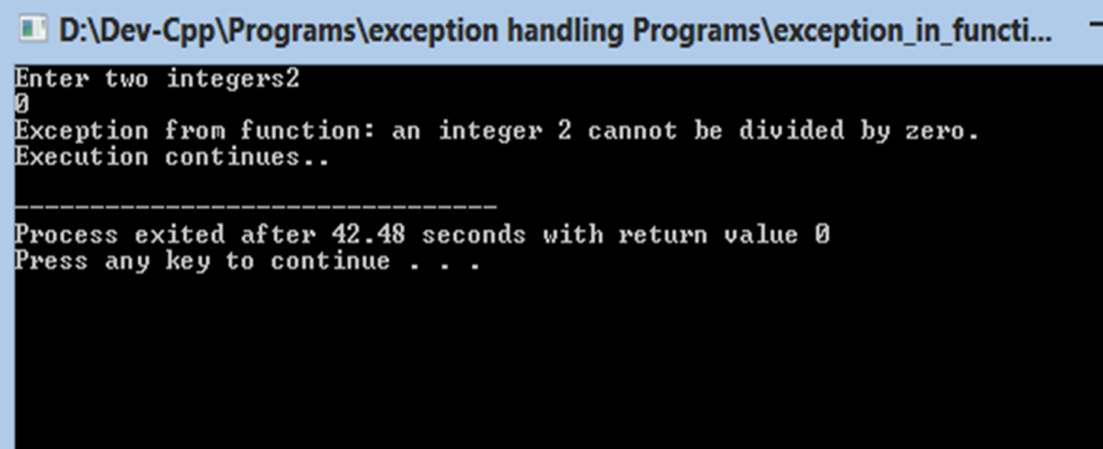

Slide 19
Applications
Helps in finding and handling run-time anomalies or abnormal conditions that a program encounters during its execution.

Slide 20
Summary
In this lecture we have discussed about Exception Handling.
We have discussed some examples of try throw catch blocks
Moreover, we have learnt about how to use exception handling in functions

Slide 21
Frequently Asked question
Q1 What should I catch?
Answer: In keeping with the C++ tradition of “there’s more than one way to do that” (translation: “give programmers options and tradeoffs so they can decide what’s best for them in their situation”), C++ allows you a variety of options for catching.
You can catch by value.
You can catch by reference.
You can catch by pointer.
In fact, you have all the flexibility that you have in declaring function parameters, and the rules for whether a particular exception matches (i.e., will be caught by) a particular catch clause are almost exactly the same as the rules for parameter compatibility when calling a function.
Q2 What should I throw?
Answer: C++, unlike just about every other language with exceptions, is very accomodating when it comes to what you can throw. In fact, you can throw anything you like. That begs the question then, what should you throw?
Generally, it’s best to throw objects, not built-ins. If possible, you should throw instances of classes that derive (ultimately) from the std::exception class. By making your exception class inherit (ultimately) from the standard exception base-class, you are making life easier for your users (they have the option of catching most things via std::exception), plus you are probably providing them with more information (such as the fact that your particular exception might be a refinement of std::runtime_error or whatever).

Slide 22
Assessment Questions:
1. By default, what a program does when it detects an exception?
a) Continue running
b) Results in the termination of the program
c) Calls other functions of the program
d) Removes the exception and tells the programmer about an exception
2. Why do we need to handle exceptions?
a) To avoid unexpected behaviour of a program during run-time
b) To let compiler remove all exceptions by itself
c) To successfully compile the program
d) To get correct output
3. How Exception handling is implemented in the C++ program?
a) Using Exception keyword
b) Using try-catch block
c) Using Exception block
d) Using Error handling schedules

Slide 23
Discussion forum.
What are the various C++ Standard Exceptions?

Slide 24

REFERENCES
TEXT BOOKS
T1 E Balagurusamy., “Object Oriented Programming in C++”, Tata McGraw-Hill.
T2 Robert Lafore, “Object Oriented Programming in C++”, Waite Group.
REFERENCE BOOKS
R1 Herbert Schildt , “C++- The Complete Reference”, Tata McGraw-Hill 2003, New Delhi.
R2 Bjarne Stroustrup: “The C++ Programming Language” (4th Edition). Addison-Wesley.
R3 Ravichandran , “Programming with C++”,Tata McGraw-Hill Education.
R4 Joyce M. Farrell,” Object Oriented Programming Using C++”, Learning.
R5 Programming Languages: Design and Implementation (4th Edition), by Terrence W. Pratt, Marvin V. Zelkowitz, Pearson.
R6 Programming Language Pragmatics, Third Edition, by Michael L. Scott, Morgan Kaufmann.
Websites:
https://www.sanfoundry.com/cplusplus-programming-questions-answers-exception-handling-1/
https://www.tutorialspoint.com/cplusplus/cpp_exceptions_handling.htm
https://www.geeksforgeeks.org/exception-handling-c/

Slide 25
THANK YOU

